Slide 1
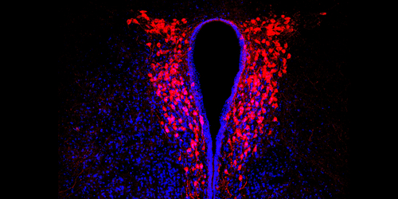
Online From Bench to Bedside
Neuroscience Network Basel Symposium
Friday 12th February 2021
Peter Scheiffele
(Biozentrum)
Annette Brühl
(University Psychiatric Clinics)
Laure Bally-Cuif
(Institut Pasteur)
Marlen Knobloch
(University Lausanne)
Botond Roska
(IOB)
Courtesy P. Scheiffele
www.bench-bed-basel.ch
Registration and Zoom ID Code at neuro@unibas.ch

